Slide 1

Technovate- Inviting
Impactful Projects
Institute of Engineering Purwanchal Campus, Dharan
Team: Tukki
Theme: Pandemic Response

Slide 2

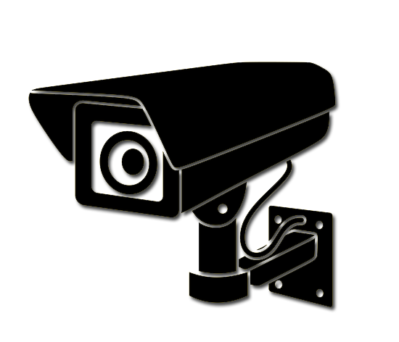
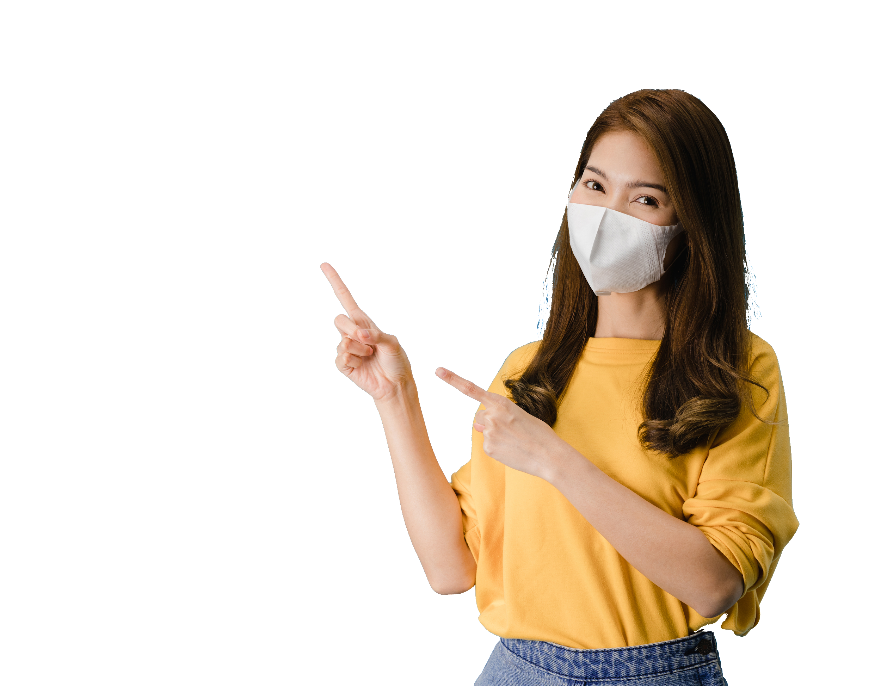
Real time facemask detector

Slide 3
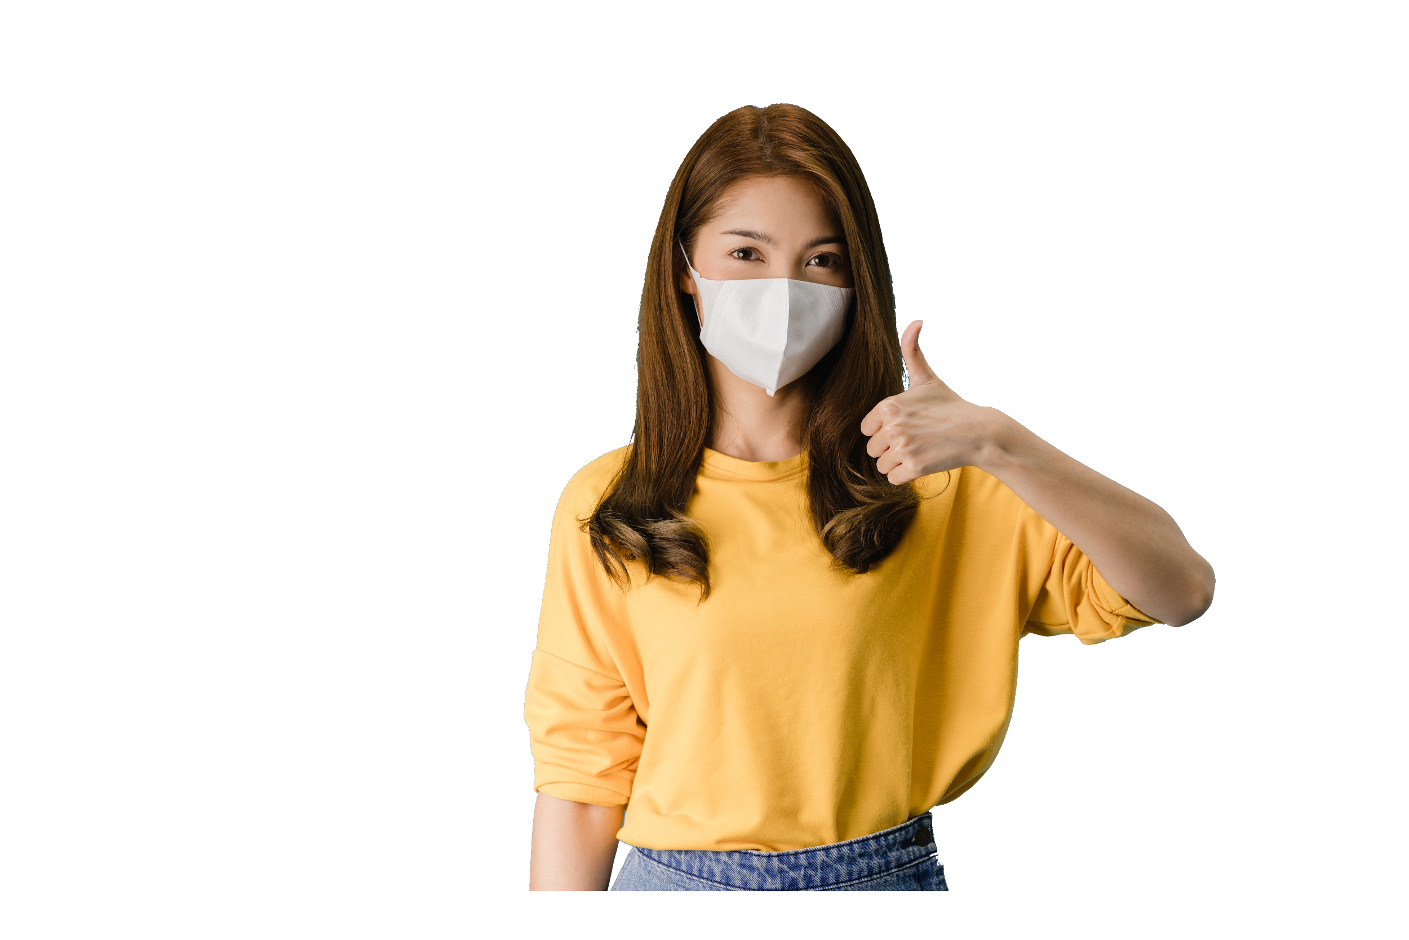
Real time facemask detector

Slide 4
Contents
1
Present Situation
Our project
2
Its Application
3

Slide 5
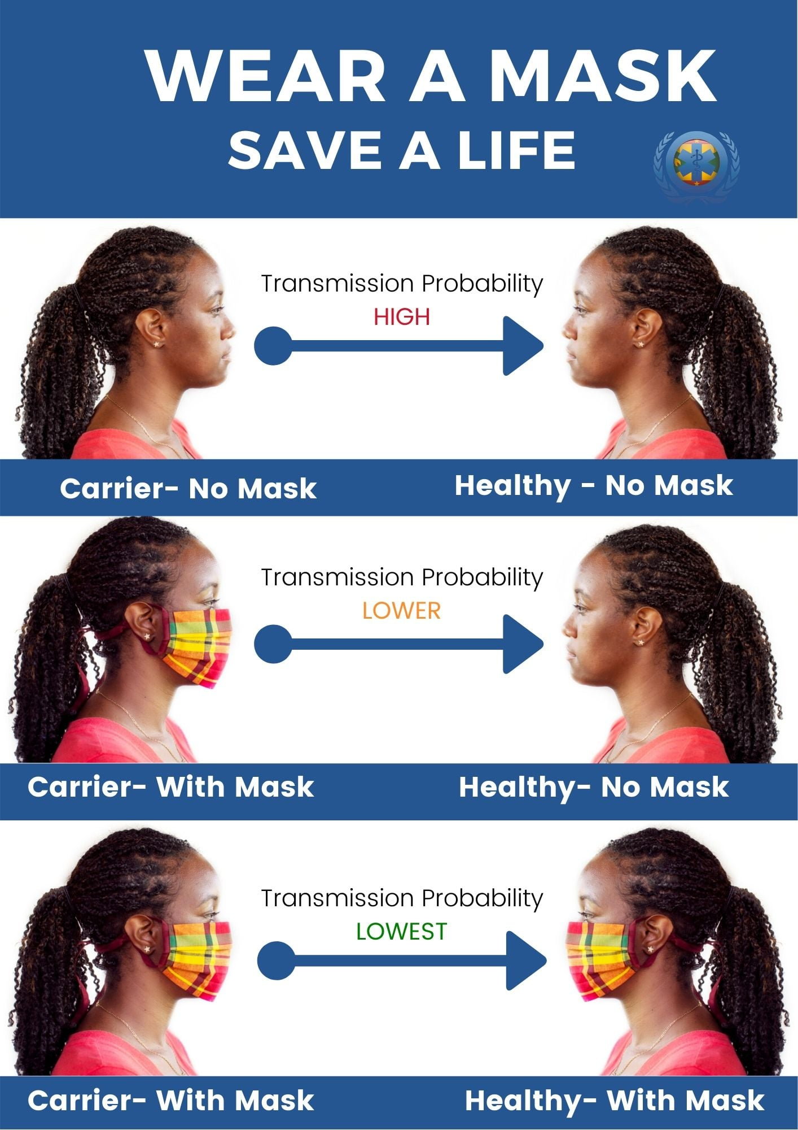
Transmission risk
https://factcheck.afp.com/misleading-mask-graphic-claims-show-exact-chance-covid-19-spread
Source:https://www.facebook.com/HealthGrenada/photos

Slide 6
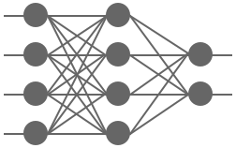
Model
Dataset
Detecting
model
Train
CNN model

Slide 7
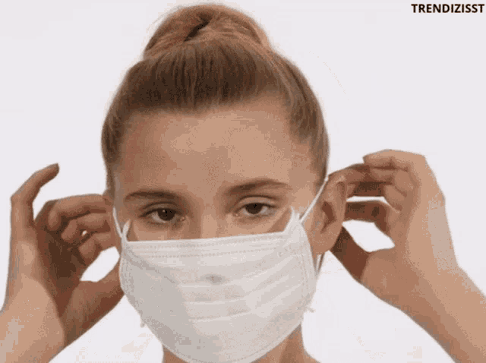
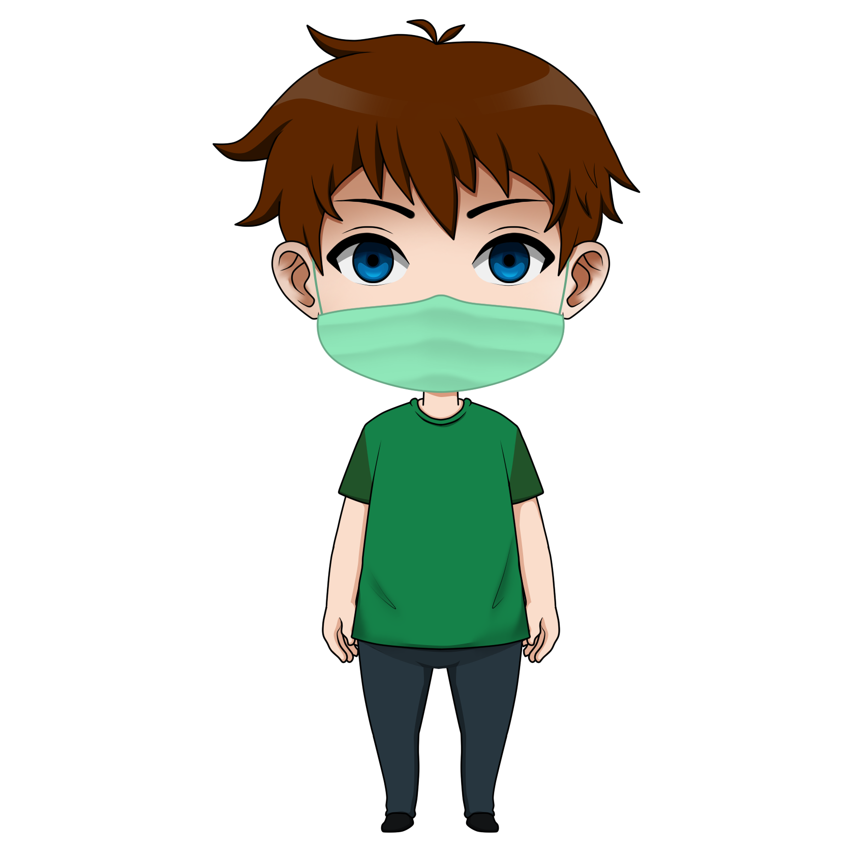

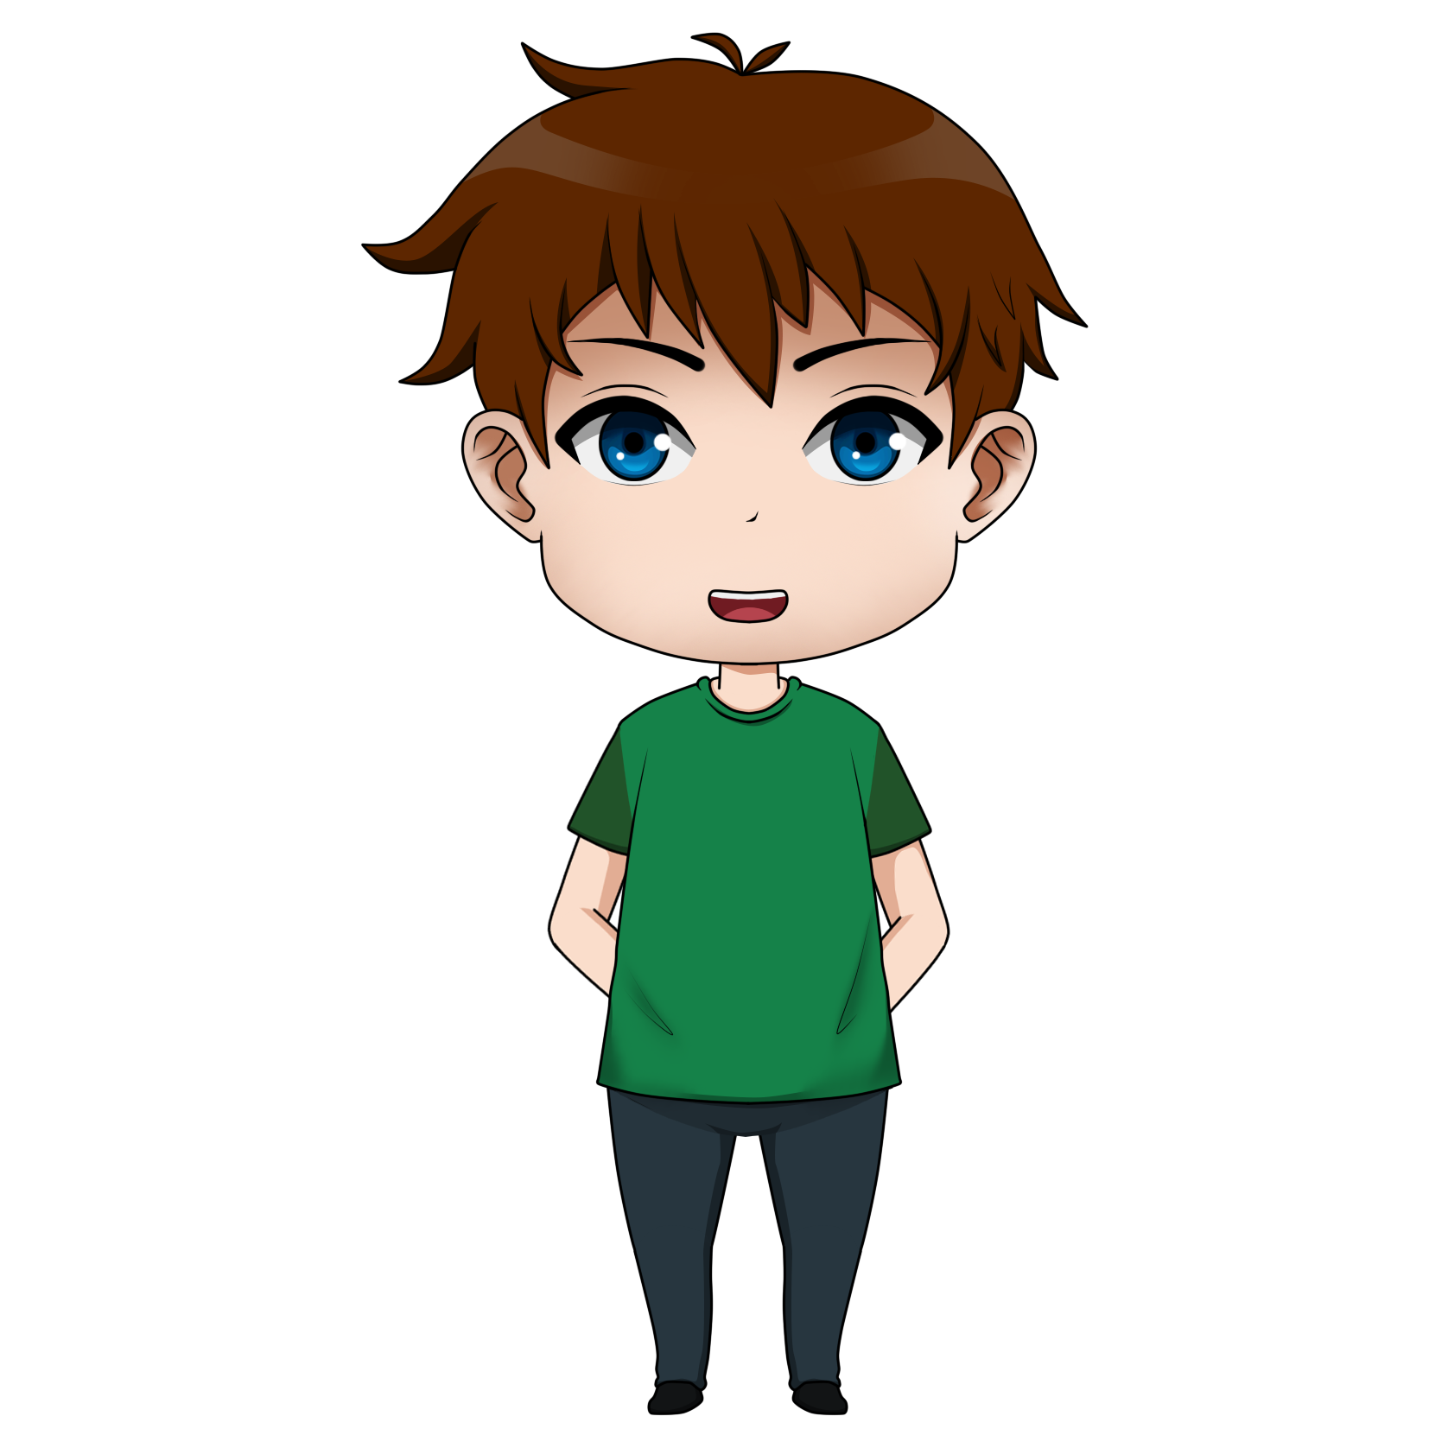
Workflow
Opencv
Read
frame
Get bounding
box
Capture
R.O.I
Open door
Display on
screen
Predict
the image
Don’t open
the door

Slide 8
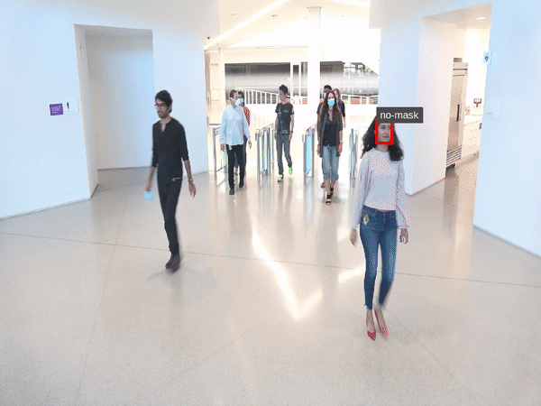
Application
Banks
ATM
Shopping malls.
Colleges

Slide 9
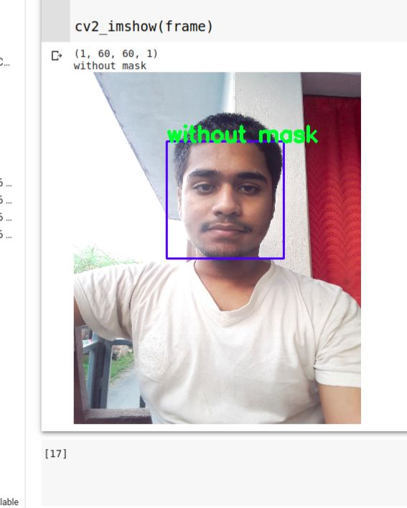
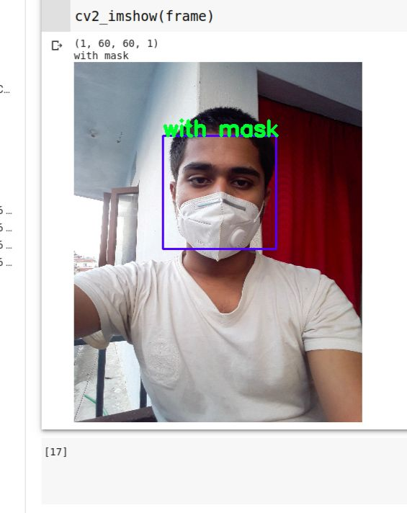
Test Image

Slide 10
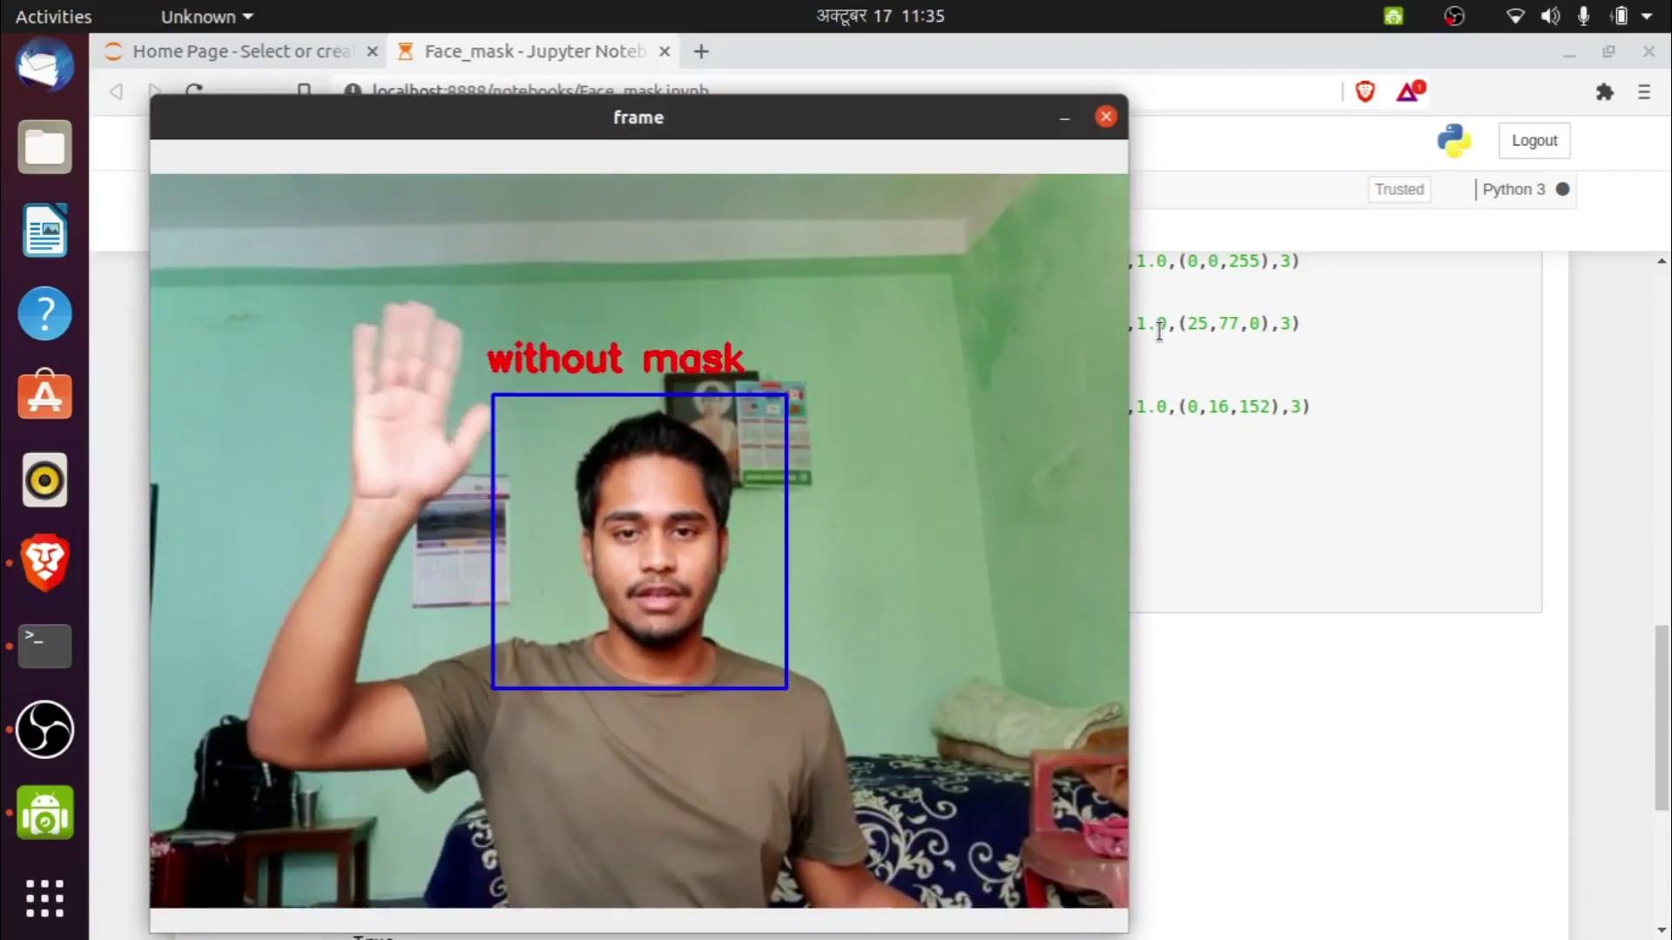

Slide 11
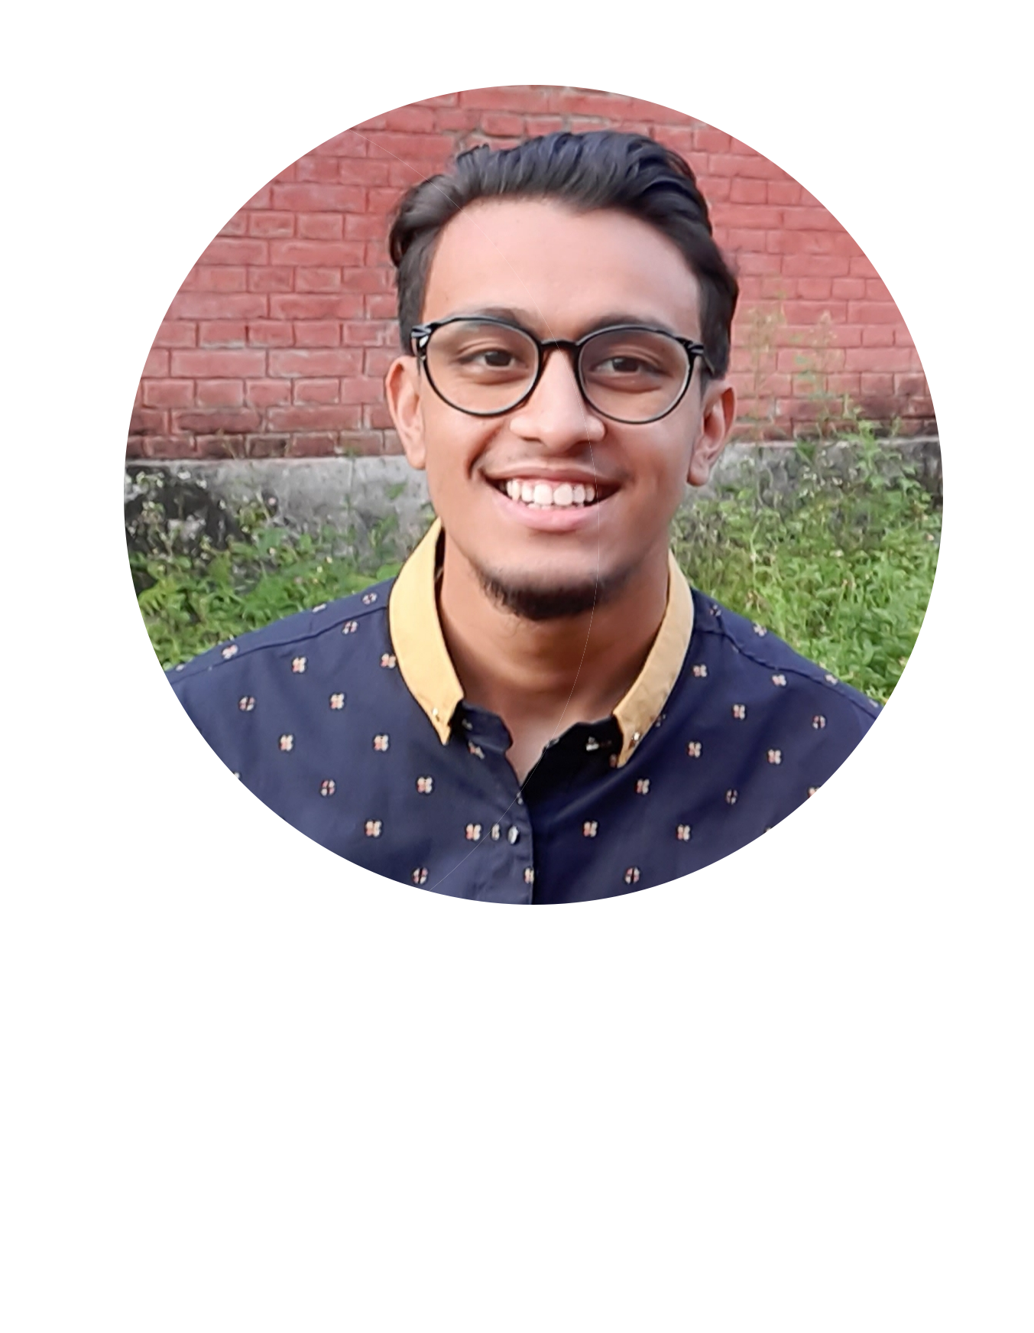
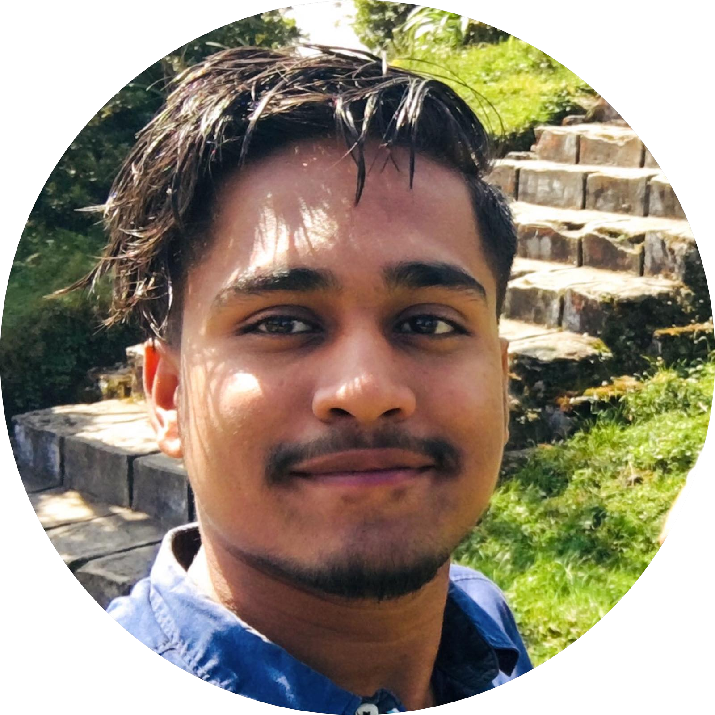
Talking about us
Thanks!
Sushant.076bei@ioepc.edu.np
saroj.076bei@ioepc.edu.np
Sushant Shah
Saroj Baniya
Electronics Communication and Information, first year.
Electronics Communication and Information, first year.
Does anyone have any questions?

